Slide 1
Aizaz Shabber Khan 2024(S)MS-DS-06

Slide 2
Early Detection of Lung Cancer Nodules through Capsule Neural Network

Slide 3
Introduction
Lung cancer is consistently ranked as the leading cause of the cancer-related deaths all around the world in the past several years.
More than one-quarter (26%) of all cancer-related deaths.
Over 50% patients survive in early-stage disease, while only 5% for late-stage disease
Early detection is the key to preventing lung cancer deaths.

Slide 4
Problem Statement
Lung cancer is a life threating disease and its early detection is a main challenging problem to save millions of lives. Previously Lung Cancer was detected by using many different neural networks like, Artificial Neural Network, Convolutional Neural Networks, etc. This thesis will attempt to employ the most latest deep learning architecture named capsule neural network (November, 2017) to automatically classify two stages of Lung Cancer. It will be an efficient work using Capsule neural network (CapsNet) for classifying 2 stages of Lung Cancer by using publicly available dataset.

Slide 5
Research Gap
Limited exploration of CapsNet applications in medical imaging, particularly lung cancer detection.
Lack of comparative studies between CapsNet and CNN for lung nodule detection accuracy.
Insufficient evidence of CapsNet's spatial preservation benefits in medical diagnosis.
Gap in understanding CapsNet performance on small medical datasets like LIDC-IDRI.
Missing evaluation of computational efficiency and deployment feasibility in healthcare settings.
Inadequate research on false positive reduction using CapsNet in lung cancer screening.
Limited studies on CapsNet's claimed advantage of requiring less training data for medical imaging.

Slide 6

Why Not CNN?
Despite of their outstanding performance CNN do not encode the special relations(positions) among the features.
Multiple pooling commonly founding CNN force the network to ignore valuable information about the location and pose of the object.
Thus this is a significant drawback for object detection task.

Slide 7
Capsule Neural Netwrok (Capsnet)
Hinton presented Capsule Neural Network (CapsNet), to address CNNs' weaknesses.
The thought is to encode the relative connections (e.g., areas, scales, directions) between nearby parts.
Perform efficient learning by using less amount of data.
Hinton and his group effectively utilized this calculation for preparing the system on manually written pictures of digits (MNIST) and successfully accomplished execution.

Slide 8
Capsule Neural Netwrok (Capsnet)
CapsNet is composed of capsules rather than neurons.
A capsule is a small group of neurons that learns to detect a particular object.
CapsNet architecture consists of two parts, encoder and decoder.
Encoder part includes a convolutional layer, a primary capsule and class capsule.
And decoder part includes fully connected layers 1, 2 and 3.

Slide 9
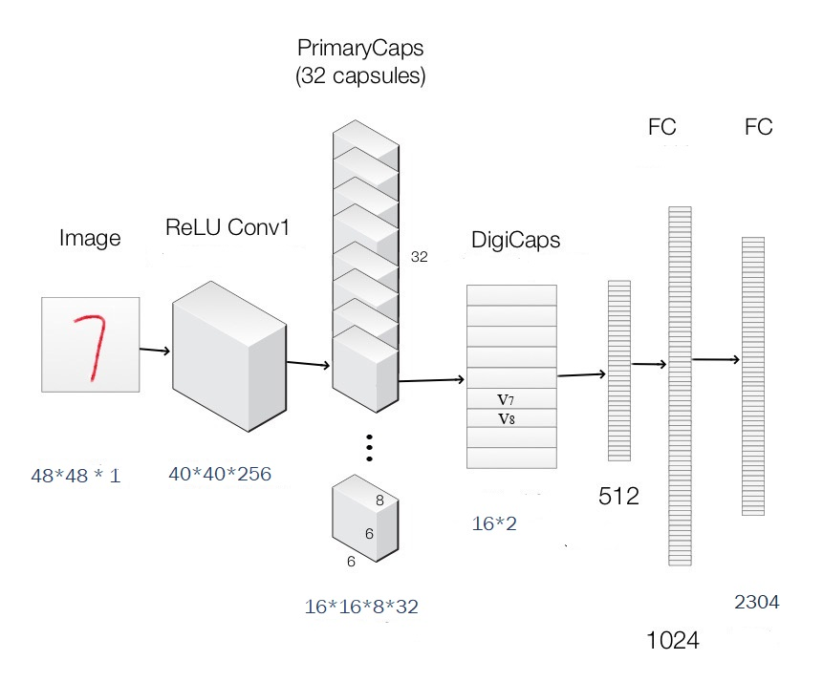
Capsnet Basic Architecture

Slide 10
Encoder Part
Convolutional layer
The goal is to extract some extremely basic features from the input image
Primary capsule layer
Now we are looking for slightly more complex shapes from the edges we found earlier.
Class capsule
each receiving input from all capsules from the layer below to perform classification based on classes.

Slide 11
decoder Part
Decoder part of the capsule network is used to reconstruct the image after the training phase.
It takes the output of the correct NoduleCaps as input and learns to recreate a same pixels image.

Slide 12
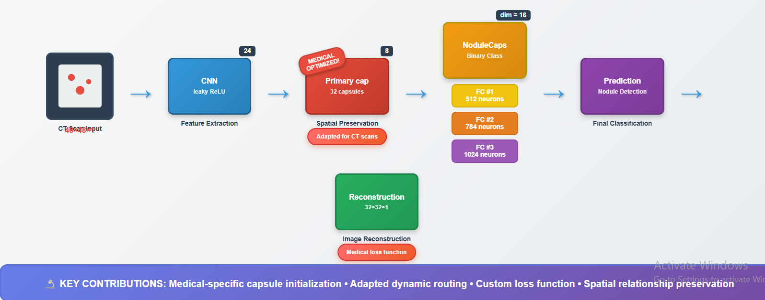
Architecture 1
Input image size of 32x32
Primary capsule layer has 32 capsules of 8 dimensions

Slide 13
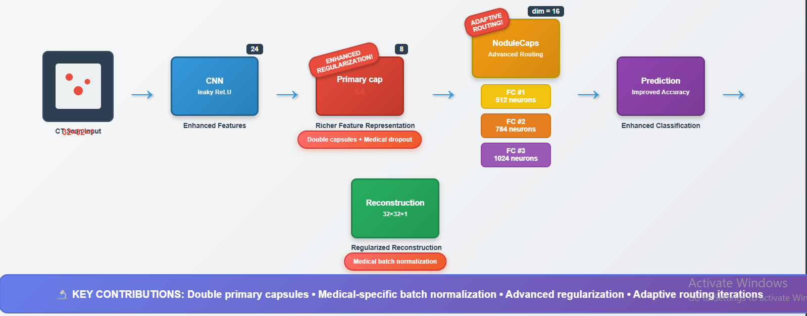
Architecture 2
Input image size of 32x32
Primary capsule layer has 64 capsules of 8 dimensions

Slide 14
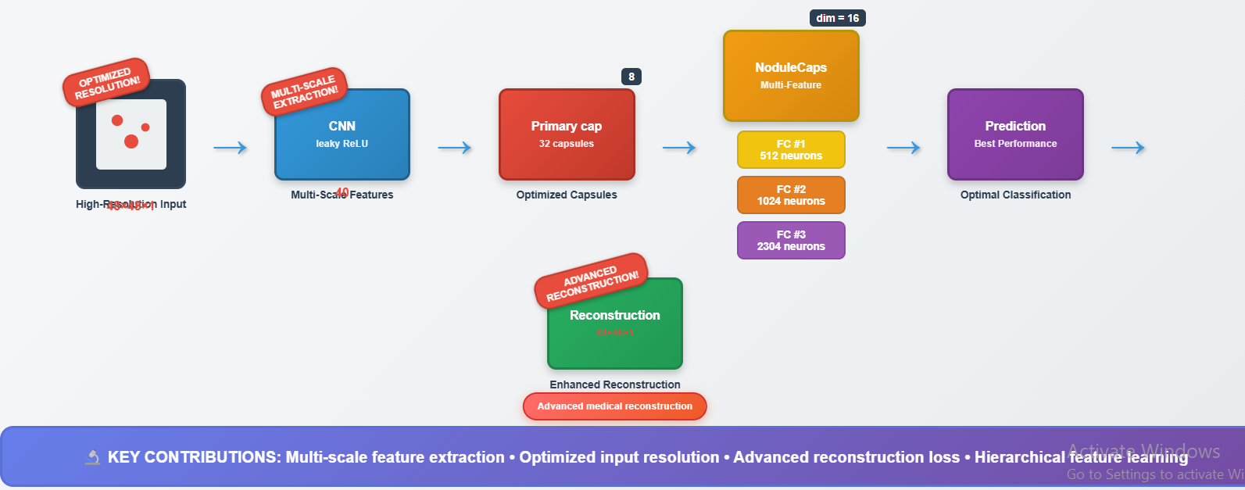
Architecture 3
Input image size of 48x48
Primary capsule layer has 32 capsules of 8 dimensions

Slide 15
Encoder Part
Convolutional layer
Image size 48*48
Output size 40*40*256
Number of parameter [(9*9*1) +1]*256 = 20992
Primary capsule layer
Input 40*40*256
Output 16*16*8*32
Number of parameter [(9*9*256)+1]*256 = 5308672
Class capsule
Input 16*16*8*32
Output (16*2)
16*16*32 =8192 input vectors/routing coefficient
Number of parameter = 8192 *(8 * 16) + 8192 + 8192 = 1,064,960
Number of parameter = 1,064,960 * 2= 2,129,920

Slide 16
Decoder Part
FC #1:
For this layer there are 16x2 inputs that are all directed to each of the 512 neurons of this layer.
number of parameters = (number of inputs + bias) x number of neurons
number of parameters = [(16*2) +1] * 512 = 16,896
FC #2:
number of parameters = (number of inputs + bias) x number of neurons
number of parameters = [(512) +1] * 1024 =525,312

Slide 17
Decoder Part
FC #3:
number of parameters = (number of inputs + bias) x number of neurons
number of parameters = [(1024) +1] * 2304 = 2,361,600

Slide 18
Hardware Specifications
Dell Latitude Optiplex 7010
3.20 GHz processor with 4 cores
16 GB RAM
Nvidia GeForce GT 760
Google Colabs (Online)

Slide 19
Technical Information
Language: Python
Tool: Anaconda Navidator
Compiler: Spyder, Jupyter Notebook
Environment: Tensorflow

Slide 20
Dataset
LIDC/IDRI
Total files 1018
This dataset is highly unbalanced dataset containing in which number of nodules are way too less than number of non-nodules.
Each file was in two formats (.mhd) and (.RAW)
Extract the (.mhd) format images into array format (.npy).
Now reconstruct images into .bmp format using array format.
Now classify the data into two classes (nodule and non-nodule).
We split the original images into sub images as per .CSV file and resize it into 48*48 image size.

Slide 21
Dataset
To balance this we used data augmentation technique.
All the candidates having nodule, we rotate the images randomly by 45 degree, 60 degree and 90 degree.
The size of nodules can be different. The biggest nodule is 32.27mm in size and the smallest is 3.25 mm in size.
we divide the dataset with double of negative images than positive images for training.

Slide 22
Results

Slide 23
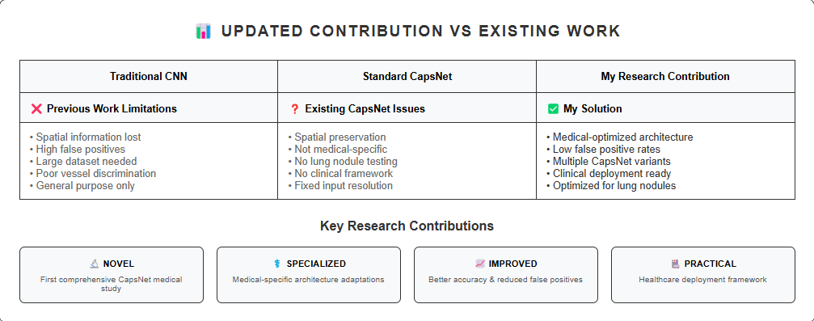
Research Contribution
Work on classifying 2 stages of Lung Cancer Nodules by using CapsNet
Evaluate results on publicly available dataset.
Compare results of CapsNet with other Neural Networks i.e. Convolutional Neural Network.

Slide 24
Reference papers
Using Deep Learning for Classification of Lung Nodules on Computed Tomography Images IEEE
Accuracy 84.15%
Lung Nodule Classification Using Deep Features in CT Images (IEEE)
75.01%

Slide 25
Thank You

